Slide 1
REVIEW-2

Slide 2
PROJECT TITLE
A MODEL TO PREDICT HEART DISEASE USING MACHINE LEARNING
TEAM NO : A9
BRANCH/SEC : CSE-A
PROJECT GUIDE:
Dr. CHAGANTI B N LAKSHMI
TEAM DETAILS:
DAMERA RAJU 19K91A0555
AFSHA 19K91A0505
ALIA VIGNESH 19K91A0506
CHILUMULA SRIJAN 19K91A0549

Slide 3
DOMAIN
MACHINE LEARNING

Slide 4

Machine Learning
Machine learning is a subset of artificial intelligence (AI). It is focused on teaching computers to learn from data and to improve with experience – instead of being explicitly programmed to do so.
In machine learning, algorithms are trained to find patterns and correlations in large data sets and to make the best decisions and predictions based on that analysis.
Machine learning applications improve with use and become more accurate the more data they have access to.
Machine learning focuses on the development of computer programs that can change when exposed to new data.

Slide 5
Why Machine Learning?
Machine learning has already found application across a huge variety of tasks and is especially important for any application that involves collecting, analyzing, and responding to large sets of data.
It gives enterprises a view of trends in customer behavior and operational business patterns, as well as supports the development of new products.
Many of today's leading companies, such as Facebook, Google, and Uber, make machine learning a central part of their operations

Slide 6
Types of ML Algorithms
1.Supervised Learning:
Supervised learning is a type of machine learning algorithm that uses a known dataset (called the training dataset) to make predictions. The training dataset includes input data and response values.
From it, the supervised learning algorithm seeks to build a model that can make predictions of the response values for a new dataset.
Algorithms include in supervised learning are Linear Regression, decision trees, Naive Bayer’s classification ..etc

Slide 7
2. Unsupervised learning:
Unsupervised learning is a type of machine learning algorithm used to draw inferences from datasets consisting of input data without labeled responses.
The task of the machine is to group unsorted information according to similarities, patterns, and differences without any prior training of data.
Algorithms include in Unsupervised learning Algorithms are:
1. Clustering
2. Hierarchical Clustering
3. K-means Clustering ..etc

Slide 8
3. Reinforcement learning:
Reinforcement learning is an area of machine learning inspired by behaviorist psychology. concerned with how software agents ought to take actions in an environment so as to maximize some notion of cumulative reward.
It is employed by various software and machines to find the best possible behavior or path it should take in a specific situation.
Algorithms include in Reinforcement learning are classification.. etc.

Slide 9
RANDOM FOREST ALGORITHAM
It is based on the concept of ensemble learning, which is a process of combining multiple classifiers to solve a complex problem and to improve the performance of the model.
As the name suggests, "Random Forest is a classifier that contains a number of decision trees on various subsets of the given dataset and takes the average to improve the predictive accuracy of that dataset."
Instead of relying on one decision tree, the random forest takes the prediction from each tree and based on the majority votes of predictions, and it predicts the final output.

Slide 10
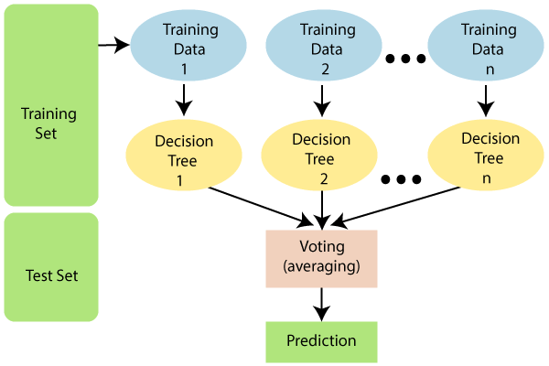
The greater number of trees in the forest leads to higher accuracy and prevents the problem of overfitting.

Slide 11
Why use Random Forest?
It takes less training time as compared to other algorithms.
It predicts output with high accuracy, even for the large dataset it runs efficiently.
It can also maintain accuracy when a large proportion of data is missing.

Slide 12
How does Random Forest algorithm work?
Random Forest works in two-phase first is to create the random forest by combining N decision tree, and second is to make predictions for each tree created in the first phase.
The Working process can be explained in the below steps and diagram:
Step-1: Select random K data points from the training set.
Step-2: Build the decision trees associated with the selected data points (Subsets).
Step-3: Choose the number N for decision trees that you want to build.
Step-4: Repeat Step 1 & 2.
Step-5: For new data points, find the predictions of each decision tree, and assign the new data points to the category that wins the majority votes.

Slide 13
Applications of Random Forest:
There are mainly four sectors where Random forest mostly used:
Banking: Banking sector mostly uses this algorithm for the identification of loan risk.
Medicine: With the help of this algorithm, disease trends and risks of the disease can be identified.
Land Use: We can identify the areas of similar land use by this algorithm.
Marketing: Marketing trends can be identified using this algorithm.

Slide 14
Advantages of Random Forest:
Random Forest is capable of performing both Classification and Regression tasks.
It is capable of handling large datasets with high dimensionality.
It enhances the accuracy of the model and prevents the overfitting issue.
Application of Random Forest in our project:
We want to boost the accuracy of dataset by using Random Forest algorithm by adding the characteristics(attributes) in dataset and also increasing size of dataset.

Slide 15
THANK YOU

